Slide 1
First law of Thermodynamics in Four Thermodynamic Processes
Adiabatic processes: In an adiabatic process, no transfer of heat occurs between the system and its environment.
Putting △Q =0 in the first law: △E=- △W
Thus if work is done on the system, the internal energy increases and if work is done by the system, the internal energy of the system decreases.

Slide 2
Constant-volume processes: If the volume of a system is held constant, that system can do no work.
Putting △W= 0 in the first law: △E=△Q
Thus, if heat is absorbed by a system, the internal energy increases and if heat is lost, the internal energy of the system decrease.

Slide 3
Cyclical processes: In this process, after certain interchanges of heat and work, the system is restored to its initial state. Thus the internal energy does not change.
Putting △E =0 in the first law: △Q = △W
Thus, the net work done must be equal to the net transferred heat.

Slide 4
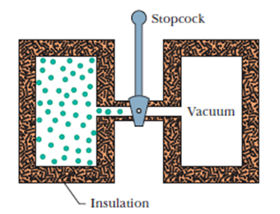
Free Expansion: These are the adiabatic processes in which no transfer of heat occurs between the system and its environment and no work is done on or by the system.
Thus, △Q = △W= 0 and the first law becomes: △E=0

Slide 5
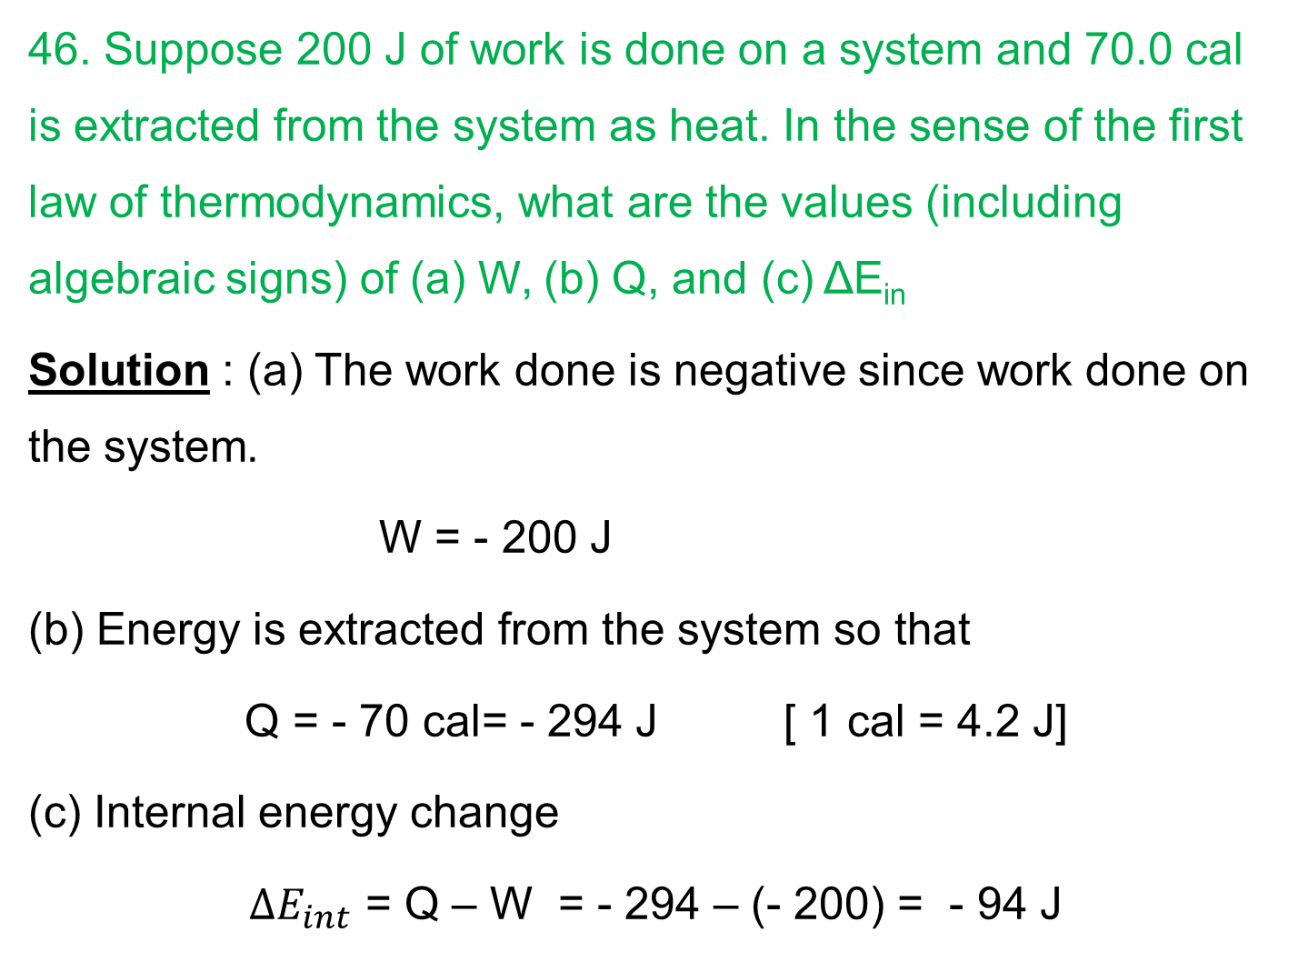
46. Suppose 200 J of work is done on a system and 70.0 cal is extracted from the system as heat. In the sense of the first law of thermodynamics, what are the values (including algebraic signs) of (a) W, (b) Q, and (c) ΔE_{in}
Solution : (a) The work done is negative since work done on the system.
W = - 200 J
(b) Energy is extracted from the system so that
Q = - 70 cal= - 294 J [ 1 cal = 4.2 J]
(c) Internal energy change
$∆E_{int}$ = Q – W = - 294 – (- 200) = - 94 J

Slide 6
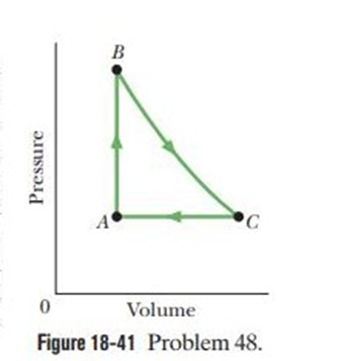

48. As a gas is held within a closed chamber, it passes through the cycle shown in Fig. Determine the energy transferred by the system as heat during constant-pressure process CA if the energy added as heat Q_{AB} during constant-volume process AB is 20.0 J, no energy is transferred as heat during adiabatic process BC, and the net work done during the cycle is 15.0 J.
Solution
First law of thermodynamics,
$∆E_{int}$= Q – W
For cyclic process, $∆E_{int}$= 0
Q = W
Q_{AB} + Q_{BC} + Q_{CA} = W
20 + 0 + Q_{CA} = 15
Q_{CA} = - 5 J

